Slide 1
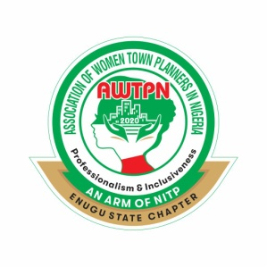
PROSPECTIVE VENTURES FOR PROFESSIONAL URBAN PLANNERS IN NIGERIA HERITAGE TOURISM AND WASTE MANAGEMENT By Dr. Onyejekwe, Ijeoma H. RTP, MNITP, MNIM, MICOMS, MEREF National Commission for Museums and Monuments ijeomaharriet70@gmail.com, finance@icomos.ng
Abstract
This lecture provides an overview of the inherent opportunities in heritage tourism and waste management for urban planners. It revealed avenues where urban planners' expertise can be effective in structural reforms of the supply side of tourism and waste to raise the Nigerian economy's standard of living and overall well-being.
Key Words
Planning, Heritage, Waste

Slide 2
Introduction
The scope of Urban and Regional Planning is vast and broad.
It transcends Keeble’s 1969 definition as an art and science of ordering the use of land, siting buildings and communication routes for practicable degree of convenience, economy and beauty. This paradigm has to a great extent, limited Urban Planners in Nigeria to specific ministries (Ministry of Works & Housing and Ministry of Lands) under the government.
It is a profession that seeks improvement in human condition through thoughtful and strategic approach in maximizing resource potentials and converting challenges to opportunities for socio – economic development to attain sustainable cities and communities. This makes the service of an Urban and Regional Planner unlimited to any Ministry and an avenue for innovation.

Slide 3
Nigeria’s Untapped Resources
Human Capital
Youthful population (53.8 % in 2020 according to World Bank).
Indigenous technologies/ Knowledge Systems .
Urban Planners.
Cultural and Natural heritage
Landscapes
Historic places
Sites
Built environments
Biological diversity collection
Cultural practices

Slide 4
Nigeria’s Challenges
Nigeria is plagued with a lot challenges – insecurity, flood, unemployment, pandemics, energy crisis, waste generation, bad governance with an escalating debt profile of N41. 6 trillion.
Against the background of this lecture, I will concentrate on waste generation.
Waste generation
The current waste generated in Nigerian cities is calculated as 66,828 tonnes per day (TPD) at the total urban population of 106 million, while the projected value for 2040 will be 125,473 TPD (Ezeudu, Agunwamba, Ugochukwu and Ezeudu, 2020).

Slide 5
Planners Opportunities' In Nigeria’s Untapped Resources
Heritage Tourism development
This form of tourism is an inclusive tourism sector development that leverages the cultural and natural heritage assets in a region through community engagement, tourism planning, product development, and institutional capacity building.
The World Bank Group (WBG, 2022) has long recognized that heritage development can play a vital role in developing countries’ efforts to promote local economic development, accelerate social integration, and alleviate poverty. Using Osun Oshogbo and Sukur Cultural landscapes both (World Heritage Sites in Nigeria) as case studies, the advantages can not be over emphasized.

Slide 6
Advantages of Heritage Tourism Development
Economic benefits; Increased incomes, gross national product (GNP) foreign exchange.
Development of Infrastructure and services.
Creation of skilled job opportunities.
Justification for environmental protection and improvement.
Correction of misconception about a place.
Promotes the tangible and intangible culture where the heritage is located.
Attracts and encourage tourists to remote areas.
It can be used as an effective instrument for local, state and national recognition.
Dissemination of IKS to youth and society.
Diversification of the economy
Increase in governmental revenue (taxes rates and duties).

Slide 7
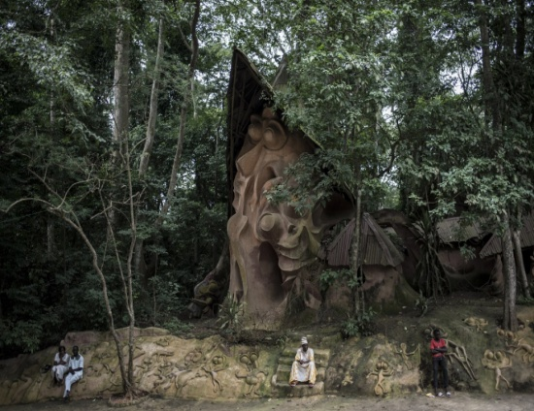
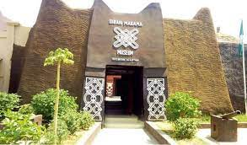
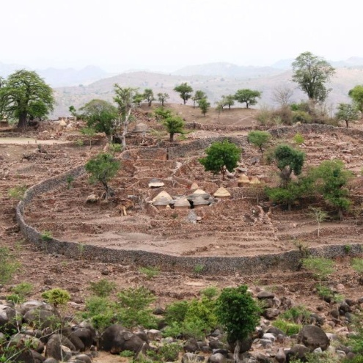
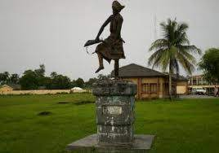
Gidan Makama, Kano State
Osun Oshogbo Groove, Osun State
Ogbunike Cave, Anambra State
Aba Women Riot mass grave and Ikot Abasi Slave Route, Akwa Ibom State
Sukur Cultural landscape, Adamawa State
Awhum Waterfall, Enugu State

Slide 8
How Planners can venture into Heritage Tourism Development
Before you procced to venture into Heritage Tourism Development, knowledge of the following are imperative -
Knowledge of the Law - In accordance to the 1972 UNESCO recommendation and the 1987 ICOMOS charter for protection of historical landscapes and cities, the Nigerian Urban and Regional Planning Law (Cap N138 LFN 2004) requires in sections 64-72 the compilation of list of places of historic interest, consultation with organizations and people with special knowledge, and seeking the consent of the National Commission for Museums and Monuments before any alteration is made on any cultural property.
Knowledge of Nigeria National Tourism Policy.
Membership of a World Bank/ United Nations recognised International professional network on heritage to participate in expert meetings, professional workshops, scientific exchanges, and training programs

Slide 9
Approach to Heritage Tourism Planning
For maximum attractiveness and Implementation,
Phase 1 – Survey and Analysis: Determine heritage sites and tourist flow by comparing existing and potential demand with existing and potential tourist attraction.
Phase 2 – Analyse to define the best option of development (this include utilities and infrastructure). Get the cost for development of each product and evaluate its profitability. Get investors (local authorities, state government, interested parties) who will control their implementation. Redefine and reanalyse the development option in collaboration with the investor.
Phase 3 – Physical Plan and Implementation: Prepare a detailed physical plan preceded by three preliminary studies that examine the additional provisions, prospective use of the site and the main destinations preferred by tourist.
Phase 4 – Seek for tourism promoters (marketing and cashflow).

Slide 10
Urban Planners Oppourtunities in Waste Generation
Challenges of waste management are aggravated by absence of solid waste master plan, lack of effective legislation, inadequate funds and services, inability of municipal authorities to provide the services cost-efficiently, changing lifestyles such as use of canned soft drinks, sachet water, PET bottles, mobile phones, computers and disposable plates and diapers.
Urban Planners can minimize this problem through the use of well designed economic instruments.

Slide 11
Economic Instrument in Waste Management
Economic Instruments are market-based incentives (MBIs) or disincentives and can change behaviour or consumption patterns and don’t substitute but complement and strengthen command and control regulations (German Agency for International Corporation, GIZ, 2015).
Economic Instruments for Solid Waste Management
Deposit Refund System (DRS): An economic instrument that requires consumers to pay a deposit which is subsequently refunded when consumers return the reusable part of the commodity (Bohm, 1981).
Extended Producer Responsibility (EPR): A policy approach in which a producer’s responsibility for its product extends to the postconsumer stage of the product’s life cycle (Walls, 2011).

Slide 12
Selection, Design and Implementation Framework of Economic Instrument for Solid Waste Management
Before you procced to select, design and implement Economic Instruments for waste management, the following are imperative –
Subscribe to online institutions researching on the development and application of economic instruments - Waste 360, Environmental Research and Education Foundation (EREF) and German Agency for International Corporation (GIZ), and countries with the relevant experience.
Knowledge of the issues in implementing economic instruments in Nigeria - natural resource use, per capita income of the citizens, tax revenue base, legal institution and her capital market should be assessed for the most suitable class and type of instrument to be implemented.

Slide 13
Phase 1
Data Collection
Establishment of Policy Goal: Both primary and secondary goals need to be specified
Phase 4
Policy Implementation
Phase 5
Monitoring and evaluation
Phase 3
•Identification of Base line Conditions: Institutional and environmenta; Mandate and power level;
Factional analysis; Long term viability of policy
Phase 2
Development of Initial Policy proposal
Stakeholders engagement

Slide 14
Acceptability of Economic Instruments
A Case Study
The choice instrument can then be modelled to suit the country’s circumstance as in the case of the study on the acceptability of Deposit Refund System under an Extended Producer responsibility for the management of PET Bottle Water Scrap (PBWS) in Enugu (Onyejekwe, Essaghah and Agukoronye, 2019). The researchers designed a system that incorporated high administrative efficiency and low oppourtunity cost of labour by involving scavengers in the collection and return PBWS to Producers. This was to augment administrative constraint and generate an active collection activity. Though the system is yet to be implemented, the acceptance by stakeholders was highly considered.

Slide 15
Conclusion
Urban and Regional Planning is a profession that seeks improvement in human condition through thoughtful and strategic approach in maximizing resource potentials and converting challenges to opportunities for socio – economic development .
Nigeria’s untapped resources in heritage tourism and challenges in waste management are veritable goldmines for Urban Planners to explore.
Heritage Tourism development and Waste management are critical in attainment of the 2030 agenda for sustainable development goals on No poverty (SDG 1), Gender equality ( SDG 5), clean water and sanitation (SDG, 6), affordable and clean energy (SDG 7), decent work and economic growth (SDG 8), Industry, Innovation and infrastructure (SDG 9), cities and communities (SDG 11), responsible consumption and production (SDG 12), Climate change (SDG 13), sustainable use of terrestrial ecosystems (SDG 15) and Partnership for the Goals (17).

